Slide 1
Cloud Virtualization

Slide 2
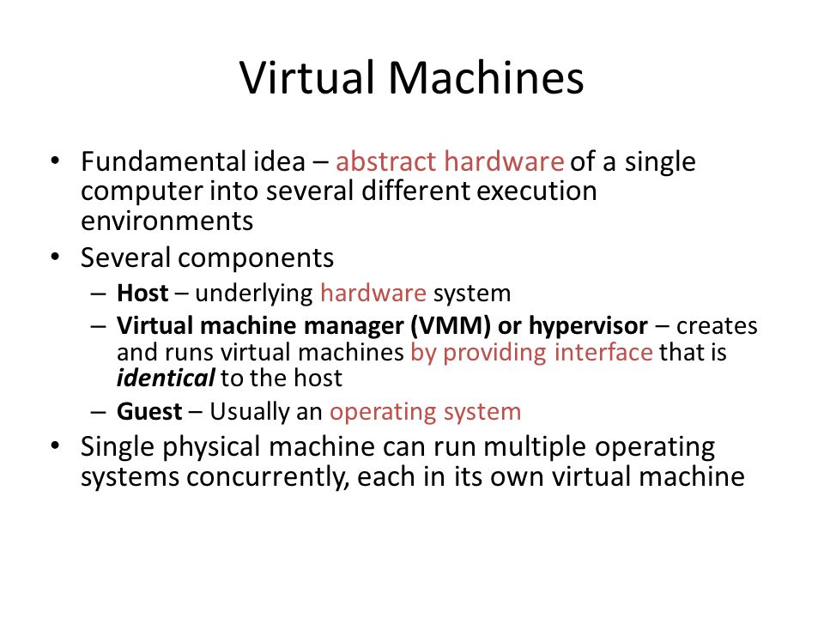

Slide 3
Enabling Technology: Virtualization
App
App
App
App
App
App
OS
OS
OS
Operating System
Hypervisor
Hardware
Hardware
Traditional Stack
Virtualized Stack

Slide 4
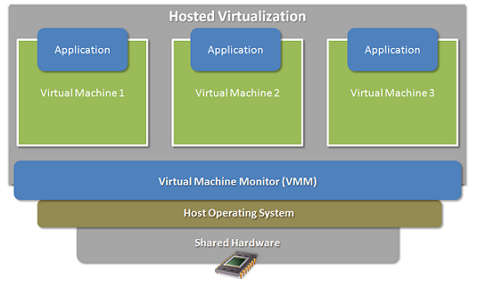

Slide 5
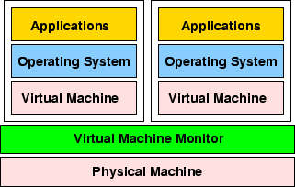

Slide 6
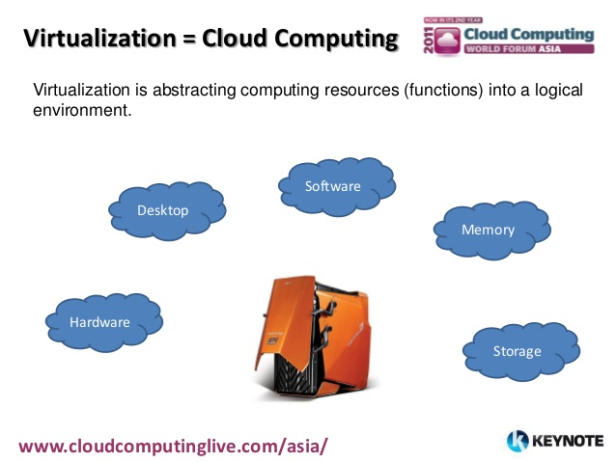

Slide 7
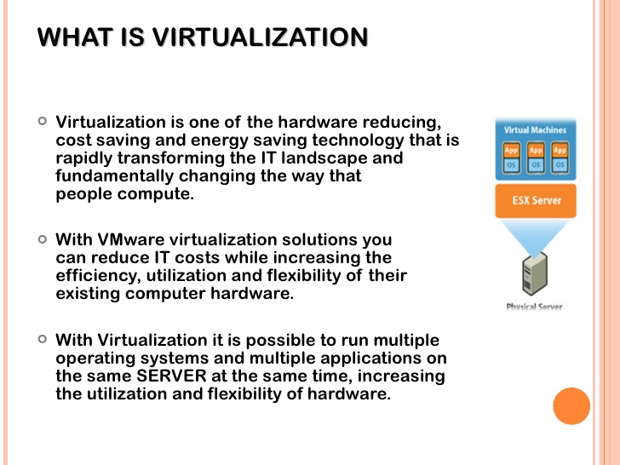

Slide 8
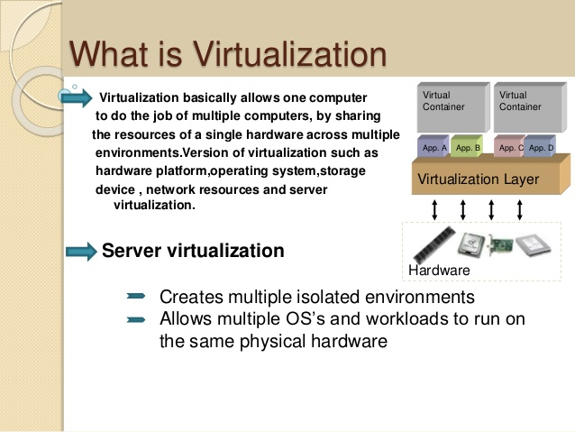

Slide 9
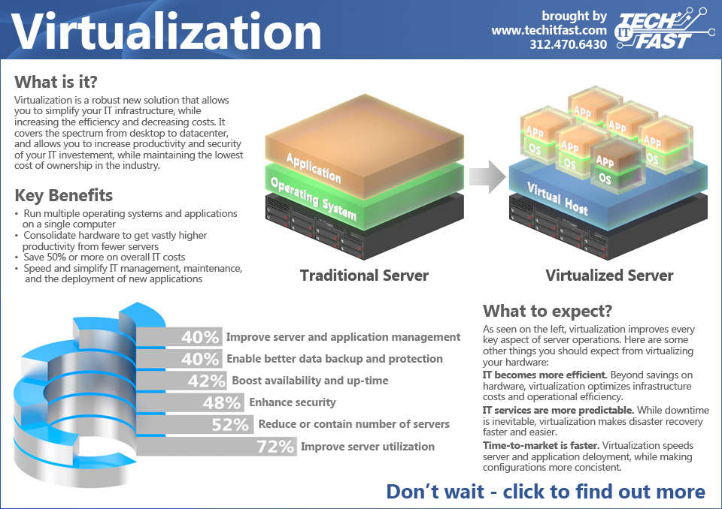

Slide 10
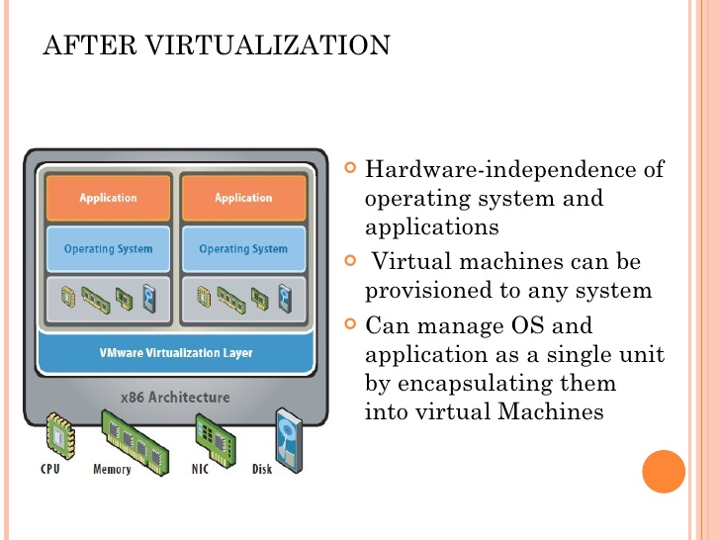

Slide 11
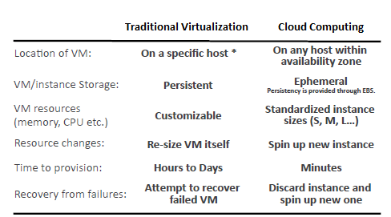

Slide 12
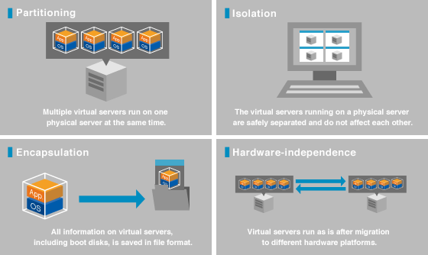
Benefits of Virtualization

Slide 13
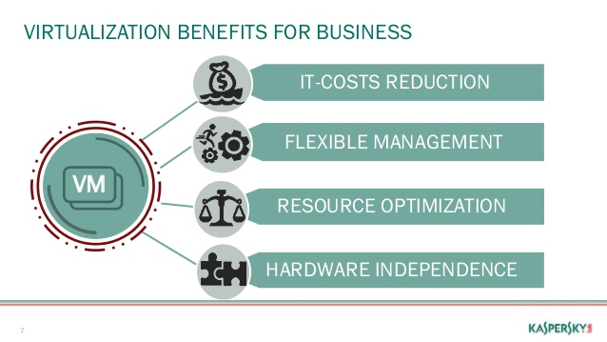

Slide 14
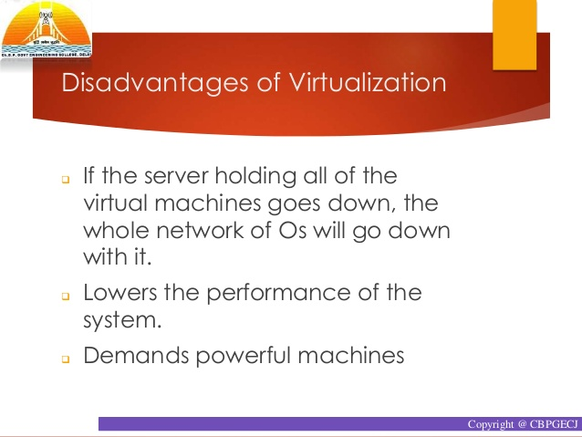

Slide 15
